Slide 1
Power Bi
i. introduction to rank, rank on single and multi dims
ii. rank with all and all selected
iii.adding ref lines to a chart and colour coding based on ref line
iv. Parameters introduction, controlling ref line and chart colour based on parameters
v. TopN ranking based on parameter and dynamic titles based on Top N rank value

Slide 2
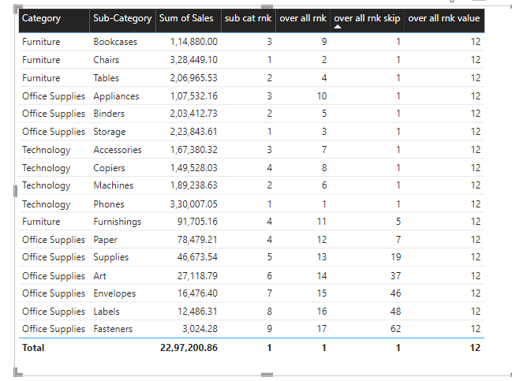
Introduction to rank, rank on single and multi dims
Rank:
Sales Amount = sum(order[Sales])
Sub Cat Rnk = RANKX(ALL(Orders[Sub-Category]),Orders[Sales Amount],,DESC,Dense)
Overall Rank = RANKX(ALL(Orders[Category],Orders[Sub-Category]),Orders[Sales Amount],,DESC,Dense)
over all rnk skip = RANKX(all(Orders[Sub-Category],Orders[Category],Orders[Region]),[sales amount],,DESC,Skip)
over all rnk value = RANKX(all(Orders[Sub-Category],Orders[Category]),[sales amount],90000,DESC,Skip)

Slide 3
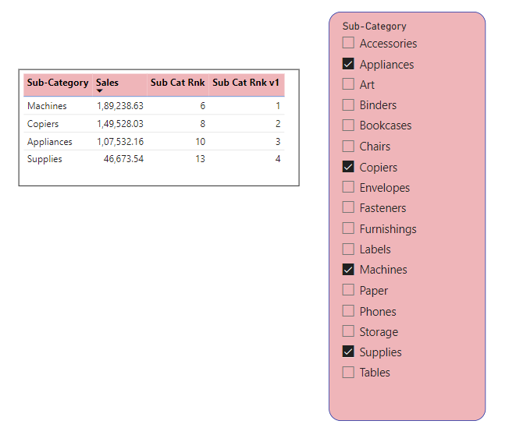
rank with all and all selected
All Selected Rank:
Sub Cat Rnk v1 = RANKX(ALLSELECTED(Orders[Sub-Category]),Orders[Sales Amount],,DESC,Dense)

Slide 4
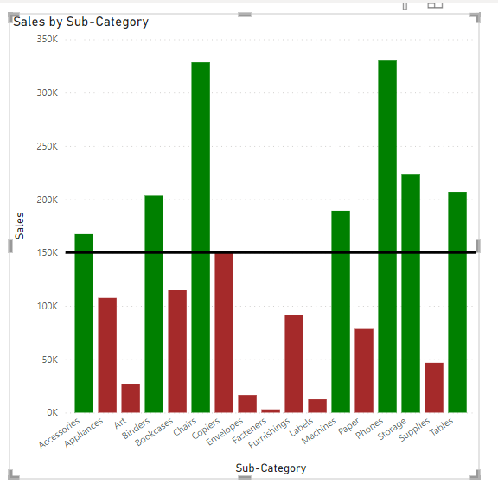
adding ref lines to a chart and colour coding based on ref line
Ref Line Tag = IF(SUM(Orders[Sales]) >= 150000,"green","brown")

Slide 5
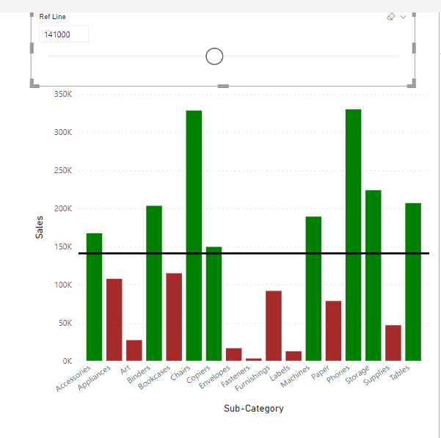
Parameters introduction, controlling ref line and chart colour based on parameters
Ref Line Tag Dyn = IF(SUM(Orders[Sales]) >= 'Ref Line'[Ref Line Value],"green","brown")

Slide 6
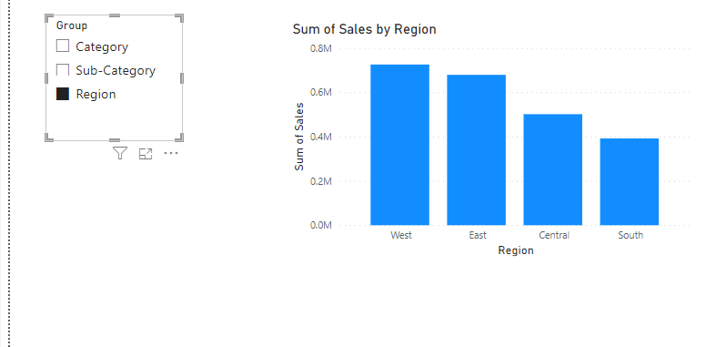
Field Parameter

Slide 7
TopN ranking based on parameter and dynamic titles based on Top N rank value
Selected Sales = IF(Orders[Sub Cat Rnk]<= 'Top N'[Top N Value],SUM(Orders[Sales]),BLANK())
Selected Sub Cat Rnk = IF(Orders[Sub Cat Rnk] <= 'Top N'[Top N Value],Orders[Sub Cat Rnk],BLANK())
Title Top N = "Top " & 'Top N'[Top N Value] & " Sub Cat on Sales"

Slide 8
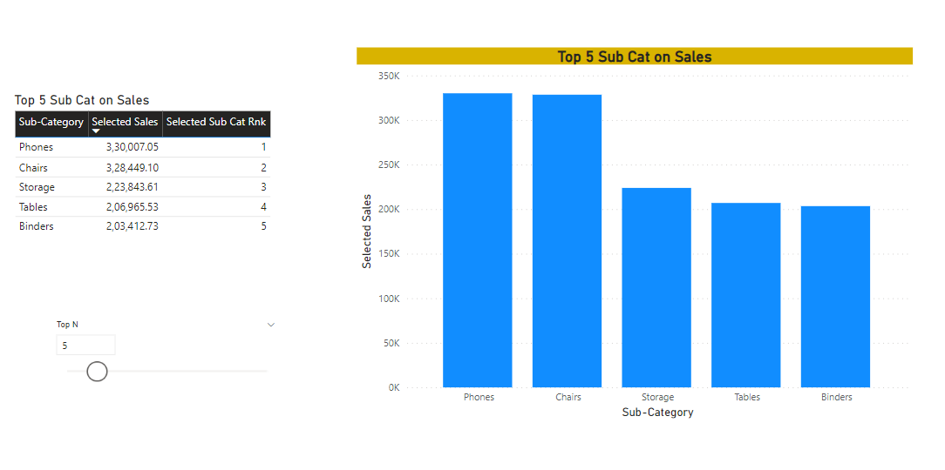
TopN ranking based on parameter and dynamic titles based on Top N rank value

